Slide 1
TIME DELAY CIRCUIT USING CD4060
MINI PROJECT

Slide 2
WHAT IS CD4060
CD4060 IC is a 14-stage counter and counter is a binary ripple carry type.
It is a CMOS logic-based binary counter belonging to a CD4000 series of integrated circuits.
It consists of a 14-stage ripple carry binary counter along with an internal oscillator.

Slide 3
CD4060 IC FEATURES
Schmitt triggered inputs which allows unlimited rise and fall times.
Fully Static operation with buffered inputs and outputs.
Counting range: 0 to 16383 (In decimal)
Maximum Clock Frequency is 30MHz at 15V.
Medium speed operation: 8MHz typ. at VDD = 10V.
Pins and function compatible with TTL series.
Reset Propagation Delay: 25ns at 5V
RC Oscillator Frequency of 690kHz Min. at 15V.

Slide 4
Pin Configuration
Pin number 1, 2, 3, 4, 5, 6, 7, 13, 14, 15 i.e Q11, Q12, Q13, Q5, Q4, Q6, Q3, Q8, Q7, Q9 respectively are the output pins.
n number 8 - is the ground of the IC.
Pin number 9 - is for External connection with capacitor for setting clock frequency.
Pin number 10 - is for External connection with resistor for setting clock frequency or Oscillator pin.
Pin number 11 - Clock pulse for setting frequency of clock.
Pin number 12 - is to Reset the value of counter to 0 and disables the oscillatorPin number 16 - Is the Vcc of IC.

Slide 5
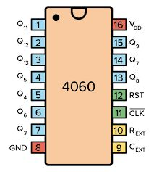
Pin configuration of CD4060

Slide 6
Application of CD4060
CD4060 is an oscillator and counter IC with 14 outputs and can be used in applications that require discrete and accurate variable time delays.
Where The first 4 pins Q0 Q1 Q2 and Q3 are not visible on the IC but they are internally used.
It can also be used for acquiring high grade and accurate oscillations of frequencies.
It is best for use in timing applications.

Slide 7
WORKING PRINCIPLE
The CD4060 IC has an in-built oscillator module.
As it is a binary counter, therefore on every negative transition of clock pulse, the counter value gets incremented by 1 in binary numbers.
The reset input should always be grounded or connected to the negative power supply. If a positive signal (1 or HIGH) is applied to this input, it will reset the counter or oscillations to start from beginning.

Slide 8
SETTING UP OF FREQUENCY
CD4060 has an inbuilt oscillator whose value is determined by the external capacitor connected to pin 11 and resistances connected to its pin 9 and pin 10.
Time delay can be changed by varying the value of capacitor or resistor. The value of the resistor at pin 11 should be roughly 10 times that of pin 10 resistor’s value and the free ends of all these components are joined together. The formula for finding the oscillation frequency is:

Slide 9


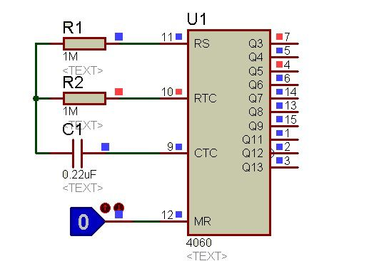
For example, we use R1=1M ohm and C1=0.22uF. Now, let’s put these values into frequency formula:

Slide 10
Therefore, with these capacitors and resistor values, the clock frequency is 1.8Hz.
In the same way, the clock period is 1/f that is 1/1.8 = 0.56 Seconds. But all output pins states will not change according to this time period.
However, they will change state in multiple of this oscillator time period.

Slide 11


How to calculate timing of Output pin?
The frequency of each output pin of CD4060 obtained will be double the previous one. If the frequency at pin 3 is 4Hz, then at pin 2 it will be 8Hz and so on. In addition to it, we can calculate the time period of each pin by this formula:
In this formula, fosc is the frequency of the oscillator. Also, n is an output pin number.
For example, if we want to determine the transition time of pin Q6. Consequently, n will be equal to 6. Now just put these values in above formula.
We get

Slide 12
CD4060 Applications Timers Time Delay Circuits for creating long time delays. Frequency divider. counter circuit. Time Delay Circuits for creating long time delays will be explained in next part

Slide 13
CD4060 as Time Delay Ckt
In previous part we learnt how to configure the clock Signal given to the IC.
Where we come across the formula of frequency of operation of the IC and also the timing consideration of each output pins of the IC.
In this document we are going to see how CD4060 can be implemented as time delay circuit.
First Step you are going to observe the speed of occurrence of the output for different values of Resistor R1 that is used in ckt.
We are going to observe the changes for the resistance values of 1k, 10K, 100k, 1M, 10M ohms.
Please refer to the below attached video's.

Slide 14
For 1k ohm
https://youtu.be/vUHSrMsgc68
https://www.youtube.com/watch?v=M3cAJie3hDA
For10k and 100k
https://youtu.be/vUHSrMsgc68
FOR 1M OHM

Slide 15
U have noticed that the speed of outputs occurred is changing as we are changing the R1 value.
By seeing this we can say that the time of occurence is changing with R1 value.
And we can say this as a time delay or time controlled ckt.
Also observed that the outputs goes on repeating until all the outputs are becoming logic state 1.
And once all the outputs are logic 1 then the IC resets automatically and the Loop again starts from beginning.
Which is not desired for our time delay application ,which can lock the output state at the desired output pin.

Slide 16
Which is not desired for our time delay application ,which can lock the output state at the desired output pin.
So to lock the IC at required output pin we use an LOW POWER SWITCHING DIODE IN4148 in B/W the output pin we want and the pin number -11.
So refer the below video to Understand the application of IN4148 diode.
https://youtu.be/N0_uYXJN_Wg

Slide 17
One more problem is that the voltage at the output pin is just around 5V. So this 5V can't be used to operate the high power appliances like turning on the lamps at time that is set using IC CD4060. So to overcome this we use the magnetic
So to overcome this we use the magnetic switching device called relay which uses small input voltage to run the low or high power external ckt.We use a diode and capacitor with the relay's input side to avoid back emf and switch debouncing. To know the relay concept refer the attached video below.
https://youtu.be/Rm7hUSk5FNM

Slide 18
Using Time delay circuit with Relay
So instead of giving that 3.3v mentioned in the video we can remove that 3.3v and can attach that terminal to the output we want to for time delay. For example if we want the output at Q9 i.e pin number 15. We remove 3.3v in the relay ckt and attached to Q9 pin of CD4060 IC. So when the output of the pin Q9 occurs then the IC is locked by IN4148 diode and the base of the transistor is given with voltage of 5v so acts as a closed switch thus makes the input side of the relay as closed ckt. Which produces the magnetic flux around the coil and that makes the magnetic needle to move to Normally opened terminal of the relay and makes external ckt to complete the loop.
https://youtu.be/7pv7Rx4JQeU

Slide 19
Team members:
SANJAY (1RN20EC81)
SAUMYA SANVI (1RN20EC82)
POORNIMA (1RN20EC137)
SHRISTI(1RN20EC136)

Slide 20
THANK YOU

